Slide 1


WELCOME
Course name: Business Studies for Engineers
Course code: BUS 405
Orientation
Focus
Mission & Vision
About
Termination
Recruitment
Outline
Description
Aim
Hierarchy
Structure
Image
Hierarchy
Organization
Informal Culture
Culture

Slide 2



Supervised by-
Mr. Md. Iftekharul Amin
Assistant Professor
Institute of Business Administration
University Of Dhaka
Orientation
Focus
Mission & Vision
About
Termination
Recruitment
Outline
Description
Aim
Hierarchy
Structure
Image
Hierarchy
Organization
Informal Culture
Culture

Slide 3


Orientation
Focus
Recruitment
Mission & Vision
About
Termination
Description
Aim
Outline
Hierarchy
Structure
Image
Hierarchy
Organization
Informal Culture
Culture

Slide 4

To study the organizational culture
Know about the structure of an organization
Get an idea about the relationship between manager and employees
Know about environment of an organization
Orientation
Focus
Recruitment
Mission & Vision
About
Termination
Description
Outline
Hierarchy
Aim
Structure
Image
Hierarchy
Organization
Informal Culture
Culture

Slide 5
About The Organization: EXIM Bank
Export Import Bank of Bangladesh Limited (EXIM Bank) is one of the leading private commercial banks in Bangladesh.
The Bank came into operation as a commercial bank on 3 August 1999 as per rules and regulations of Bangladesh Bank.
From its establishment the bank was known as BEXIM Bank Limited. But due to legal constraints, the bank was renamed as EXIM Bank, which stood for Export Import Bank of Bangladesh Limited.
As of May 2018 the bank has operations across the country with 118 branches and 64 ATM booths.
By July 2004 the bank has migrated all of its conventional banking operation into Shariah based Islamic banking.
Orientation
Focus
Recruitment
Mission & Vision
About
Termination
Description
Outline
Organization
Hierarchy
Aim
Image
Hierarchy
Structure
Informal Culture
Culture

Slide 6
EXIM Bank Focuses On:
Money Laundering & Terrorist Financing Prevention Activities.
AML & CFT Questionnaire for Correspondent Relationship.
Wolfsberg Financial Crime Compliance Questionnaire (FCCQ) of EXIM Bank.
Wolfsberg Correspondent Banking Due Diligence Questionnaire (CBDDQ) of EXIM Bank.
AML Call Report: Standard Information about EXIM Bank.
Focus
Orientation
Mission & Vision
About
Termination
Recruitment
Outline
Description
Organization
Hierarchy
Aim
Image
Hierarchy
Structure
Informal Culture
Culture

Slide 7
Vision:
The gist of our vision is "Together Towards Tomorrow".
Exim Bank believes in togetherness with its customers,
in its march on the road to growth and progress with service.
To achieve the desired goal.
There will be constant pursuit of excellence in compliance
with the Islamic Shariah.
Mission:
Focus
Orientation
Extracting the full benefit of Islamic banking system for its customers.
Providing with quality financial services especially in Foreign Trade.
Maintaining and upgrading a technology-based professional banking environment.
Sound capital base.
Maintenance of corporate and business ethics.
Ensure sustainable growth for the honorable stakeholders.
Fulfillment of corporate social commitments, and above all, to add to the national economy.
About
Recruitment
Mission & Vision
Termination
Description
Outline
Organization
Hierarchy
Aim
Image
Hierarchy
Structure
Informal Culture
Culture

Slide 8
Organizational Structure
The bank manages its business and operation vertically from the head office through 5 distinct types of banking :
Retail Banking
Corporate Banking
SME Banking
Agri Banking
Remittance
Focus
Orientation
Mission & Vision
About
Termination
Recruitment
Outline
Description
Organization
Image
Hierarchy
Structure
Aim
Informal Culture
Hierarchy
Culture

Slide 9
Office Description
EXPORT IMPORT BANK OF BANGLADESH LIMITED
HEAD OFFICE
"SYMPHONY" Plot # SE (F): 9, Road # 142 Gulshan Avenue, Dhaka- 1212 Phone: 880-2-9889370, 9889468, 9889375, 9887025, 9889648, 9889363, 9891489 Fax: 880-2-9889358 E-mail: info@eximbankbd.com
We are visiting
IMAMGONJ BRANCH
Address: Holding # 16-17, Noorani Center, 1st & 2nd Floor,
Imamgonj, Chawkbazar , Dhaka - 1211
Phone: 02-57315528, 02-57315529, 02-57342155
Email: imamgonj@eximbankbd.com
Fax: 880-2-7315530
Focus
Orientation
Description
Recruitment
Mission & Vision
About
Termination
Structure
Outline
Organization
Image
Hierarchy
Aim
Informal Culture
Hierarchy
Culture

Slide 10
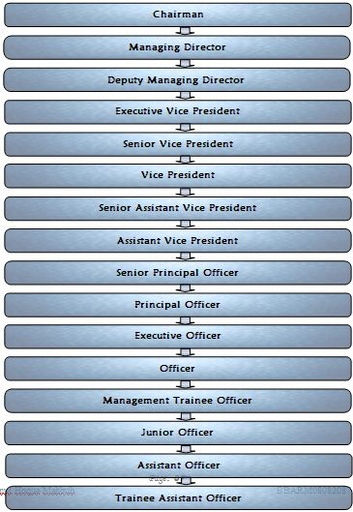
Managerial Hierarchy (management level) :
Focus
Orientation
Mission & Vision
About
Termination
Recruitment
Description
Outline
Structure
Organization
Image
Hierarchy
Hierarchy
Aim
Informal Culture
Culture

Slide 11
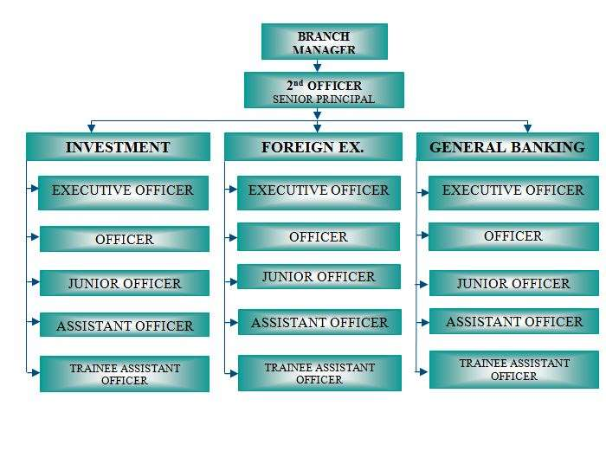
Managerial Hierarchy (executive and operational level) :
Focus
Orientation
Mission & Vision
About
Termination
Recruitment
Description
Outline
Structure
Organization
Image
Hierarchy
Aim
Informal Culture
Culture
Hierarchy

Slide 12
Recruitment Policies:
All permanent employees are hired through job circulation on newspaper.
Employees with no prior experience are aptitude tested.
Eligible applicants are interviewed.
Successful applicants are sent offer letters.
Offer letter contains all the terms of employment and organizational regulations.
Focus
Orientation
Hierarchy
Mission & Vision
About
Termination
Description
Outline
Structure
Organization
Image
Recruitment
Aim
Informal Culture
Hierarchy
Culture

Slide 13
Orienting new employees :
They have a training & research academy called EXIM Bank Training & Research Academy (EBTRA).In This academy they played a very important role. They are oriented many ways:
To encourage growth and career development of all employees of the bank.
To improve Bank's effectiveness by providing employees development on job related knowledge, skills and attitude (KSA).
To update different pertinent skill and knowledge of employees for organizational development.
To demonstrate and project as market leader relating to knowledge, skill & competencies.
To generate a positive motivation for individual future growth.
To create a learning and professional culture in the bank.
Focus
Orientation
Hierarchy
Mission & Vision
About
Termination
Description
Outline
Structure
Organization
Image
Recruitment
Aim
Informal Culture
Hierarchy
Culture

Slide 14
Corporate Culture
The culture and values of this bank have been proved as a source of competitive advantage for us.
They are acting as a key component to establish the relationship between the bank and employees.
In turn , between their employees and our customers.
They are culture and values also encourage customers and employees to join us and stay with us.
EXIM Bank has also been able to improve organizational performance via improving the performance of individual contributors.
Focus
Orientation
Hierarchy
Mission & Vision
About
Termination
Description
Outline
Structure
Organization
Image
Recruitment
Aim
Informal Culture
Hierarchy
Culture

Slide 15
Informal Culture of the Organization
Many employees have their own workplace nicknames.
Birthdays are celebrated by cutting cakes and giving
cards both of which are sponsored by the employee’s immediate in line manager .
“Cricket Match”, “Football Match”, “Carom Competition” are held on occasionally.
Annual picnic held on end of the year.
Corporate Social Responsibilities:
Healthcare service.
Scholarship program for brilliant poor student.
Helping people in slum areas.
Donation to educational institutions to setup computer lab.
Beautification of Dhaka City.
Focus
Orientation
Hierarchy
Mission & Vision
About
Termination
Description
Outline
Image
Structure
Organization
Recruitment
Aim
Informal Culture
Hierarchy
Culture

Slide 16
Employee Termination:
Employees are dismissed if and only if they are known to have made a significant mistake.
Employees can quit their work, be terminated from work or be dismissed.
Informally an employee might be pressurized to quit his job by his superiors, if he performs poorly.
Zero Tolerance to Violence whistle Blower in the workplace.
The- bank shall not tolerate any type of
harassment by directors, employees, supervisors or others.
Focus
Orientation
Hierarchy
Mission & Vision
About
Termination
Description
Outline
Structure
Organization
Image
Recruitment
Aim
Informal Culture
Hierarchy
Culture

Slide 17
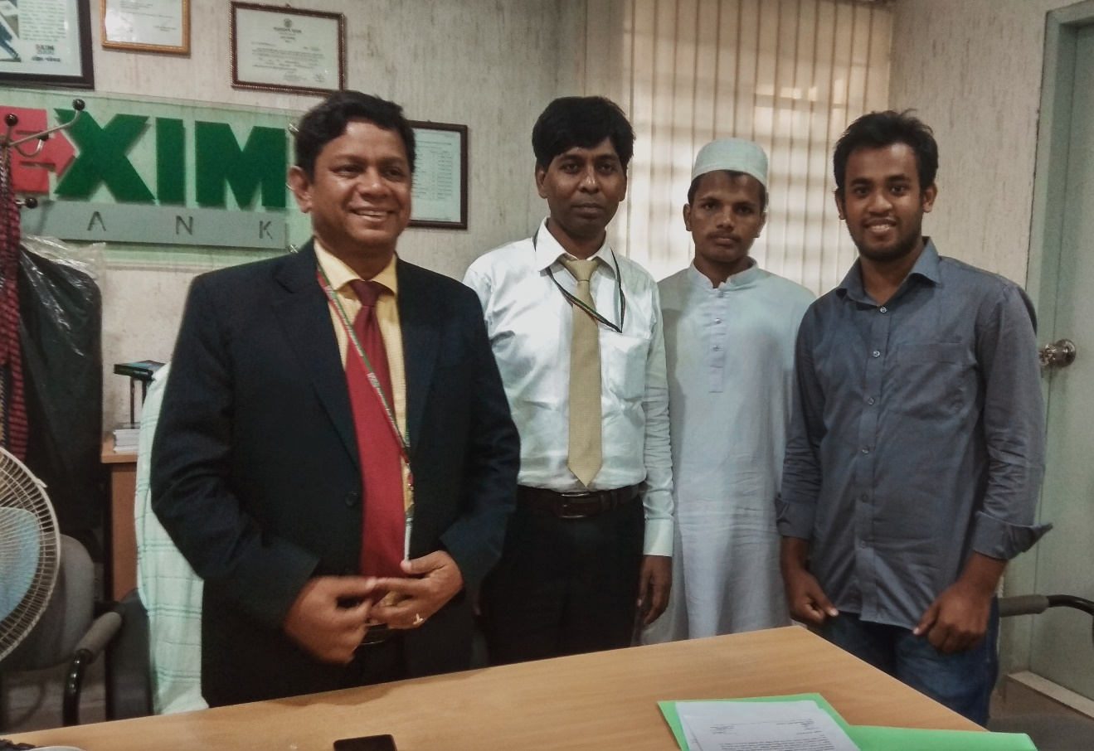
Images from the visit
Focus
Orientation
Hierarchy
Mission & Vision
About
Termination
Description
Outline
Structure
Organization
Image
Recruitment
Aim
Informal Culture
Hierarchy
Culture
With
Dr. Md. Saiful Islam
Vice President & Relationship Manager

Slide 18
Thank you
Thank you
Thank you
Focus
Orientation
Hierarchy
Mission & Vision
About
Termination
Description
Outline
Greeting's
Structure
Organization
Greeting's
Greeting's
Recruitment
Aim
Informal Culture
Hierarchy
Culture

